Slide 1
Gamification of Computational Problems
By: Under:
Milind Chauhan(IIT2014117) Dr Rishi Ranjan Singh
Suresh K. Dhayal(IIT2014060) Asst. Professor.
Navratna Sharma(IIT2013148) IIIT-ALLAHABAD

Slide 2
Motivation
Puzzle games generally have a simple premise.
swap tiles to form matches (candy crush)
combine tiles with the same number on it to form tiles with a greater number (2048) etc.
The premise is simple so the game is easy to pick up, but the goal is hard.
For eg: Can you match enough tiles to reach a particular score in candy crush?
Can you combine enough tiles of same number to finally get the tile with the number 2048 on it?

Slide 3
Motivation
It turns out that many of the questions that can be asked about the goals of these games are also NP-Complete (also NP-hard).
For eg: In 2048, given an m x n board, is it possible to obtain a tile of value 2048 is NP-Complete [4],
In candy crush, can a score of ‘s’ or more be achieved in some ‘k’ swaps is NP-Complete [3] and so on.
This makes the study of NP-Hard games interesting. How many more games out there are NP-Hard?
Can a new game be developed based on an NP-Hard problem? These are the question that we wish to seek the answers to in this project

Slide 4
Objectives And Targets
To analyze already existing games that are NP-Hard. There are many games that are already proven to be NP-Hard. So we already analyzed a few games like Bejeweled, Candy Crush Saga.
To study and learn the process of proving games to be NP-Hard. To prove that a problem is NP-Hard, you need to have a polynomial time algorithm that reduces an instance of a known NP-Hard problem into an instance of your NP-Hard problem. How is it done in games is special constructs are designed called ‘gadgets’ that help in reducing an instance of an NP-Hard problem into an instance of the game.
To finally propose and build a new game based on an NP-Hard Problem.

Slide 5
Methodological Steps
Analyzed the proof that tile matching match-3 type games are NP-Hard. For eg: Bejeweled and Candy Crush Saga. Bejeweled Game: The Reduction is of an instance of 1in3 Positive 3Sat (1in3PSAT) which is NP-Hard problem with ‘n’ literals and ‘m’ clauses into with the goal of satisfying the clauses such that each clause has exactly one literal set to the value of TRUE into an instance of a generalized case of Bejeweled with a board of w x h with goal of popping out a specific gem ( goal gem ).

Slide 6
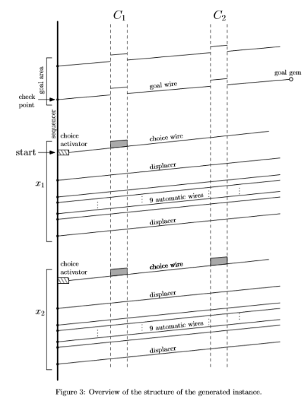
Methodological Steps
There are a total of six gadgets:
The Sequencer
The Choice Activator
The Choice Wire
The Displacer
The Automatic Wires
The Goal Wire

Slide 7
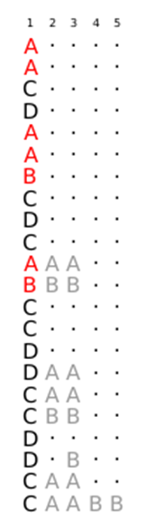
Methodological Steps
Sequencer The first column in its entirety is the sequencer gadget. It has two main functions: Passing the control from one variable to next. Activating the displacers and the automatic wires. In the figure, the parts in red are the parts that will activate the wires by coming in contact with them and forming a match and thus popping out. The parts in grey are example gadgets that do nothing except interact with the sequencer

Slide 8
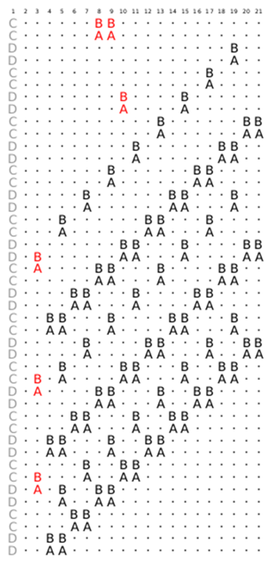
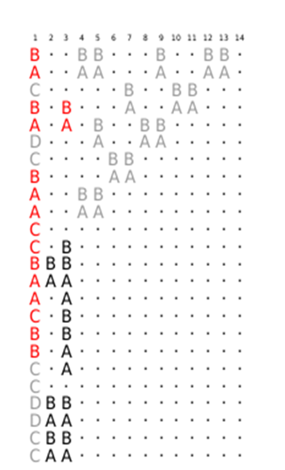
Methodological Steps
The Choice Wire (And Activator)
Whenever you set the choice activator for a variable to TRUE, the choice wire is set in such a way that it get it’s popped out in its entirety via a set of consecutive matches.
Each clause is represented by a set of three consecutive columns the locations of which are represented by the formula: (2*j + 6, 2*j + 8), where j = 1 for the first clause and so on.

Slide 9
Methodological Steps
The Choice Wire (And Activator) The gadgets ensure that all rows fall by a number that is a multiple of six, while the clauses columns have extra gems for the literals they contain. If the clause is satisfied by the assignment of its literals, those extra gems match up to make the clause columns fall by 2 extra rows and line up with the goal line. If all the clauses are satisfied then the goal line becomes complete and then it is easy to pop the goal gem. Hence an instance of 1-in-3 positive SAT problem is reduced to an instance of the bejeweled problem of popping a specific gem.

Slide 10
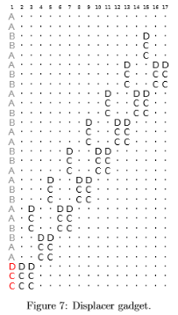
Methodological Steps
Displacer Its construction is quite simple. Once activated with the proper sequencer record, a chain of pops will ensure that even columns fall by 3 cells while odd columns fall by 6 cells. Displacer in order to guarantee that the total number of gems popped in each column during the whole process will be a multiple of 6.

Slide 11
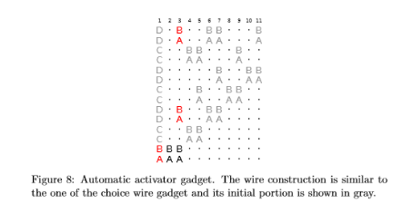
Methodological Steps
Automatic wire An automatic wire is very similar to the choice wire Except it has no additional gems on the columns corresponding to the clauses . The automatic activator is a very simple gadget that has the sole purpose of automatically activating a wire whenever its sequencer record falls in place.

Slide 12
Methodological Steps
Goal wire The task of the goal zone is to ensure that the truth assignment resulting from the variable gadget activations is a satisfying assignment. If this is the case, it will result in the possibility to reach the goal gem from the check point .

Slide 13
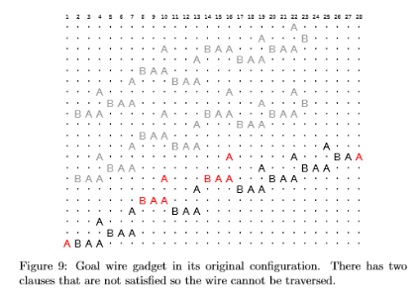
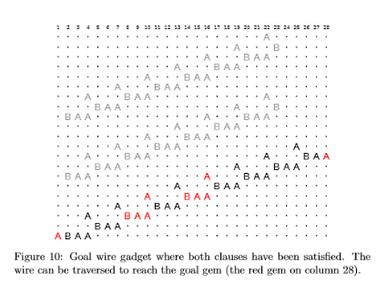
Methodological Steps

Slide 14
Methodological Steps

Slide 15
Methodological Steps
We then decided to develop a game based on an NP-Hard problem.
Following are the candidates for the problems that we would build a game on:
The Clique Problem
The Graph Coloring Problem
The Travelling Salesman Problem

Slide 16
Methodological Steps
We decided to go forward with the graph coloring problem.
The Graph Coloring Problem: Given an undirected connected graph G(V,E), and a number k (except 0,1 and 2), is it possible to assign colors to vertices such that no adjacent(connected) vertices have the same color and the total no. of colors used is equal to or less than k.
We then implemented a game in the form of a web app. So we had to utilise, html, css, and javascript.

Slide 17
Result
The Finished Game: FillUP
The player is started off with a randomly generated graph and five colors which they then have to use to color the vertices of the graph.
The player cannot assign a color to a vertex if any adjacent vertex has the same color.
The player has to fill all the vertices with the color within the given time.
If the player succeeds in doing so, they may advance to the next level.
The score of the player depends on the amount of colors they use, with usage of 3 colors resulting in the highest score and usage of 5 resulting in the lowest
Each successive level adds more vertices and edges to the graph to make the level harder.
The objective of the user is to reach the highest level.

Slide 18
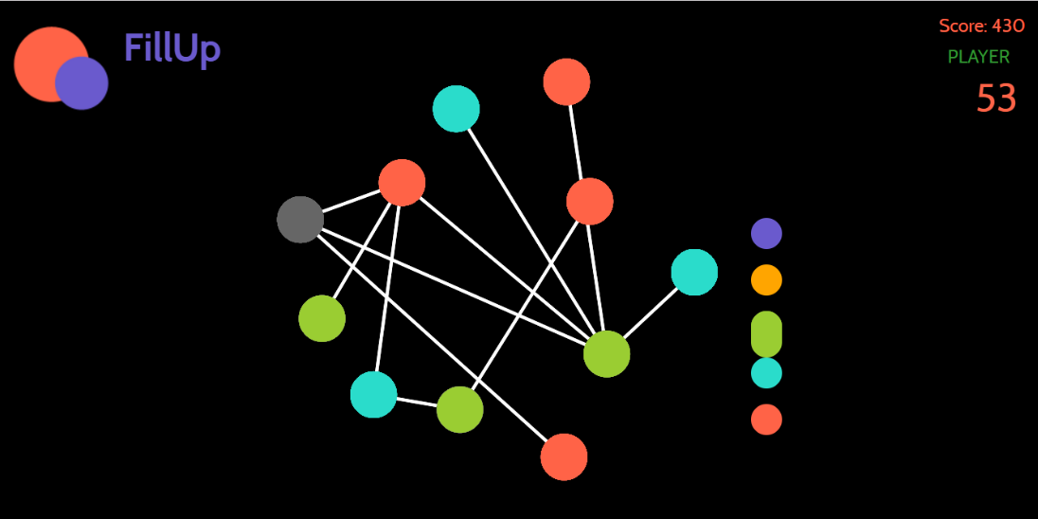
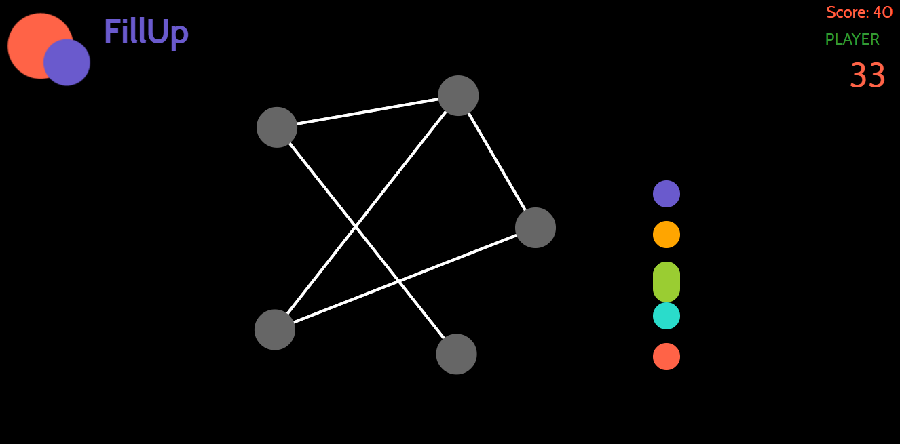
Result

Slide 19
Conclusion And Future Work
Successfully developed the game on a computational problem.
Future work:
Porting the game to mobile platforms like android, ios.
Adding a harder difficulty mode for the game where the no. of colors available is limited to the chromatic no. of the graph.

